Slide 1


Using Calcium Isotope Fractionation to Measure Bone Density
Lily Wayne
Mentors: Dr. Wang Zheng PhD., Dr. Steve Romaniello PhD., Dr. Ariel Anbar PhD.
Arizona State University
April 18, 2020

Slide 2
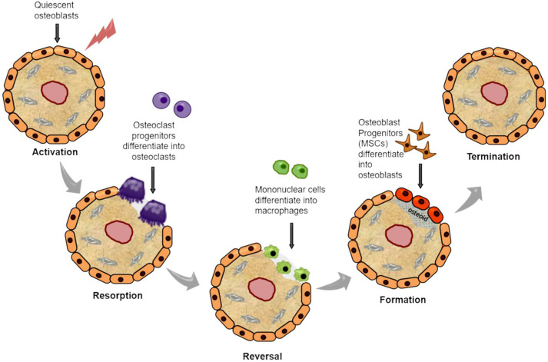
Background Information
Bone remodeling
  Bone formation vs. bone resorption
  Mineral balance: rate of bone formation = rate of bone resorption
Imbalance leads to osteoporosis
Current method used to measure bone mineral density: DEXA
  Limitation: Low sensitivity
Alternative method? Calcium isotope fractionation

Slide 3
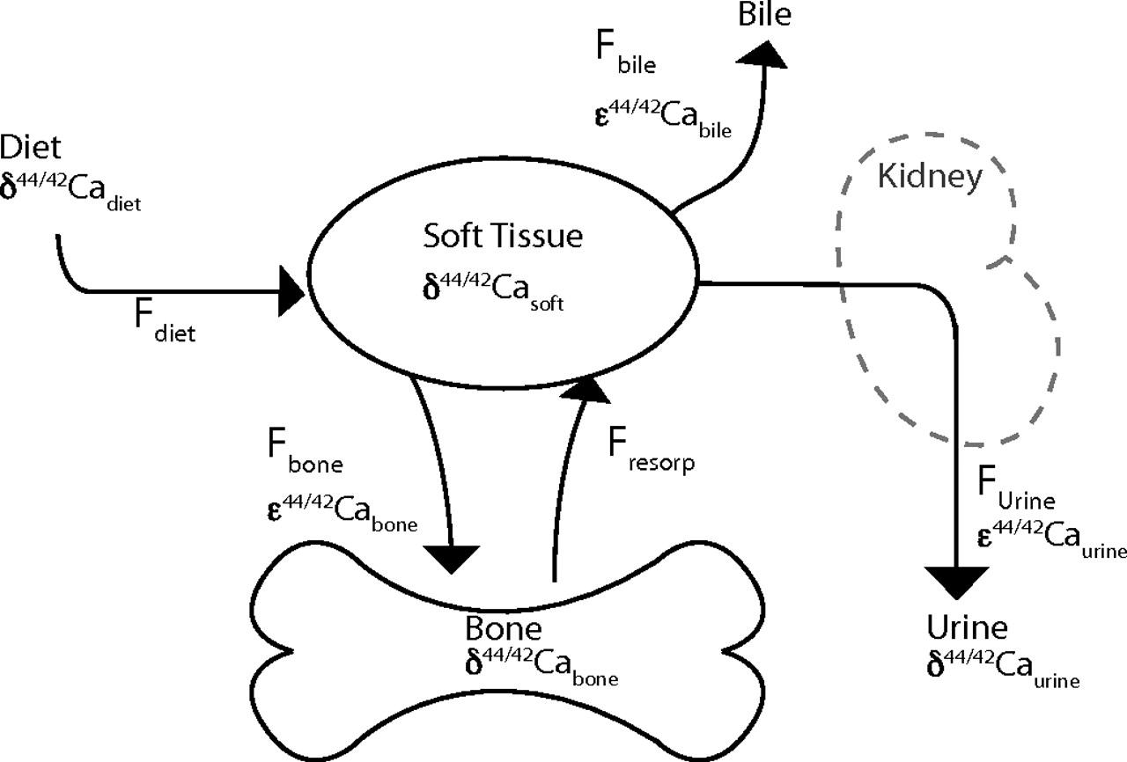
What is Calcium Isotopic Fractionation?
Change in ratio of Ca isotopes due to differences of reaction rates of each isotope
Lighter isotopes more reactive
Bone formation: light Ca isotopes deposited → heavier serum Ca isotopic ratio
Bone resorption: light Ca isotopes released → shift to lighter serum Ca isotopic ratio

Slide 4
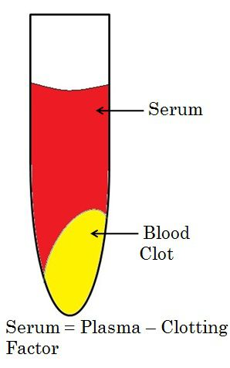
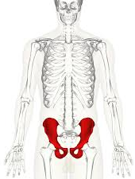
Research Objective
To quantify the offset of Ca isotope composition between bone and serum
Clinical application: Non-invasive instrument used to measure bone mineral density
  Advantage:
    high sensitivity
    can detect small changes in bone density
    early diagnostic/prevention tool

Slide 5
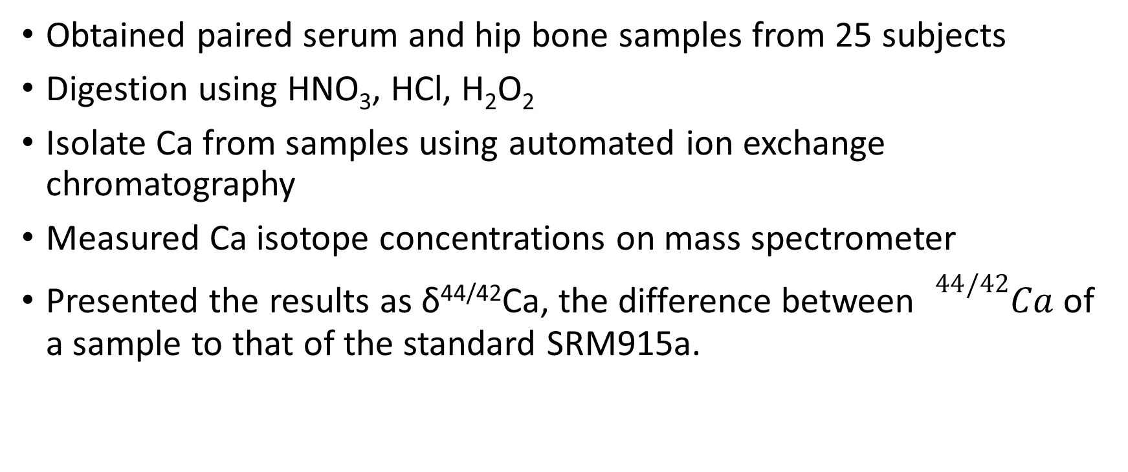
Research Outline
Obtained paired serum and hip bone samples from 25 subjects
Digestion using HNO₃, HCl, H₂O₂
Isolate Ca from samples using automated ion exchange chromatography
Measured Ca isotope concentrations on mass spectrometer
Presented the results as δ^{44/42}Ca, the difference between ${}_{0}^{44/42}{Ca}$ of a sample to that of the standard SRM915a.

Slide 6
Figure 1. δ^{44/42}Ca as a function of age. Calcium isotopes of cortical and trabecular bone were plotted for each of the 25 subjects.

Slide 7
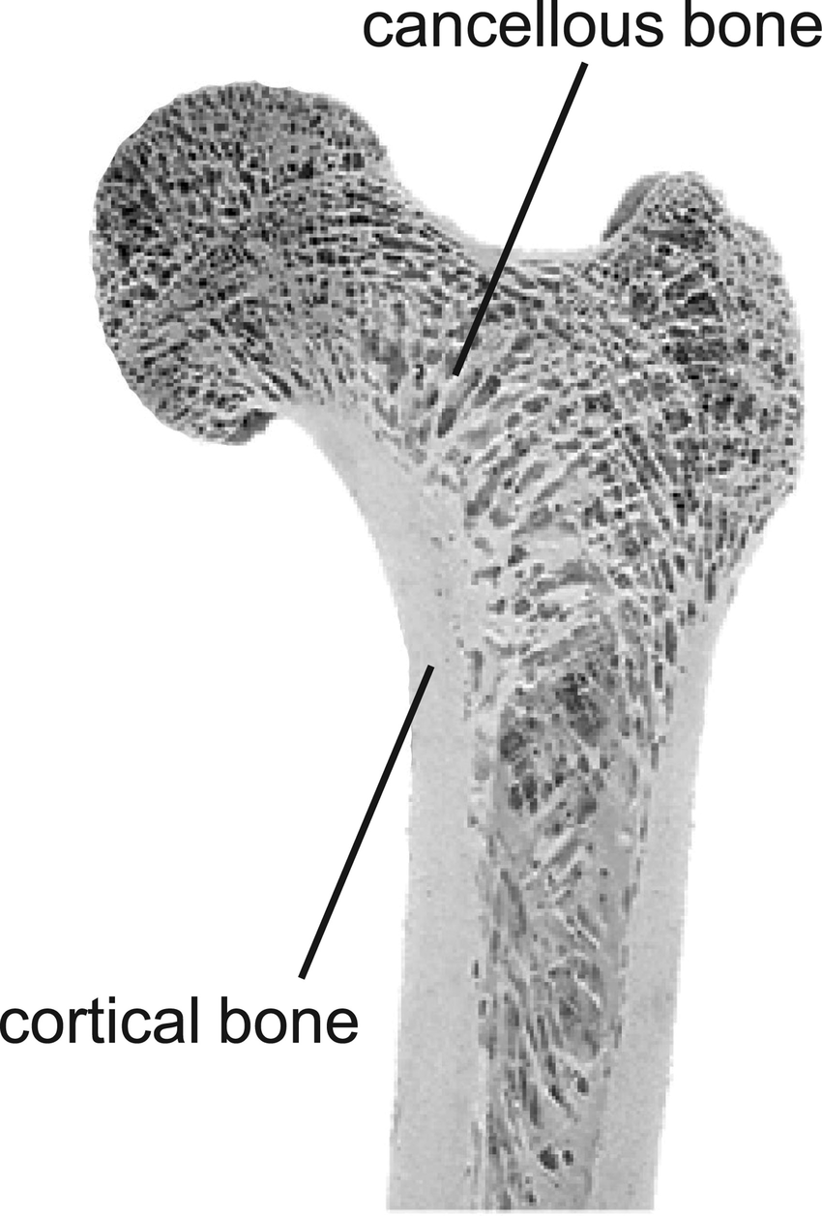
Results/Interpretations
trabecular bone
All δ^{44/42}Ca values are negative
  Loss of Ca → low bone density
δ^{44/42}Ca is relatively stable with age.
  Ca isotopic shift similar among older and younger individuals experiencing bone loss
δ^{44/42}Ca for cortical and trabecular bone of an individual are similar
  Both outer and inner bone affected to same degree during resorption

Slide 8
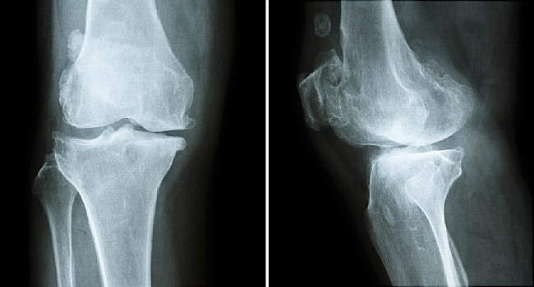
Conclusions
During bone formation and resorption, Ca isotopic shifts occur
Shift in Ca isotopic ratio can be quantify to measure degree of bone loss
Clinical applications as diagnostic tool of metabolic bone diseases
Next step:
  measure δ^{44/42}Ca of serum samples
  Calculate the offset of δ^{44/42}Ca between serum and bone.

Slide 9
Acknowledgements
Steve Romaniello, Associate Professor at University of Tennessee Knoxville
Wang Zheng, Professor at Tianjin Univeristy
Gwyneth Gordon, Assistant Research Professor at ASU
Ariel Anbar, President’s Professor at ASU
ASU/NASA Space Grant

